Slide 1
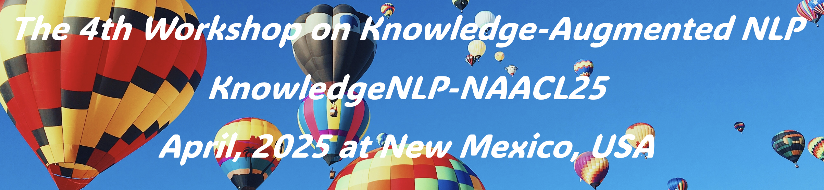
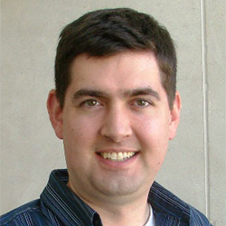
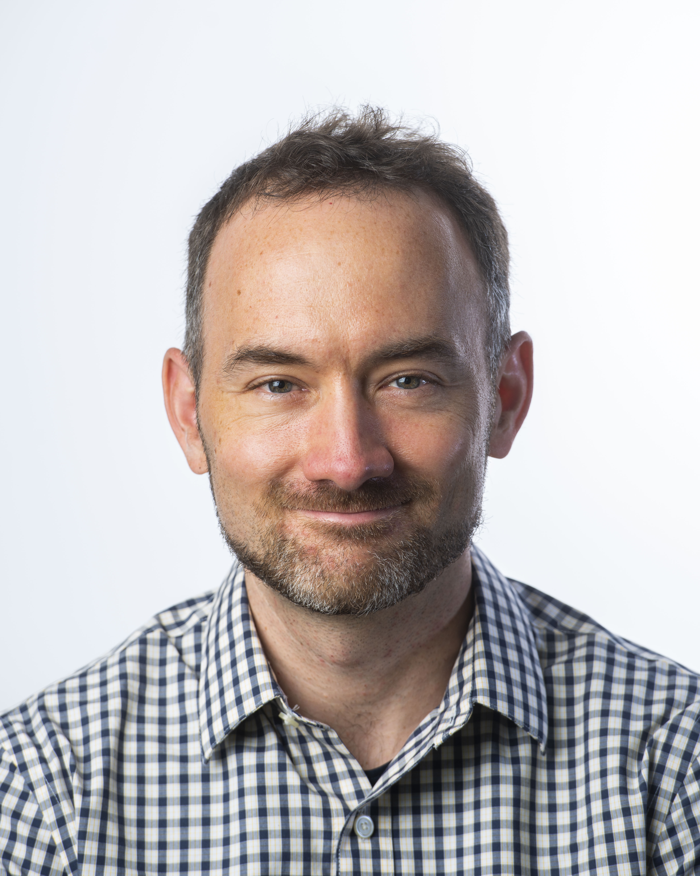
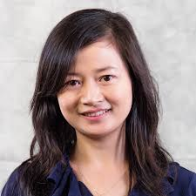
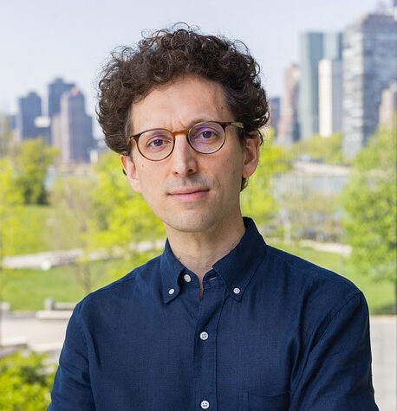
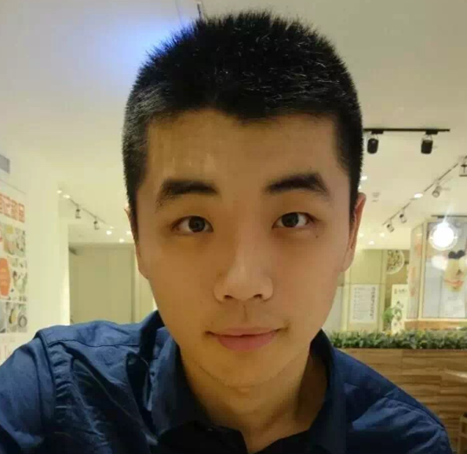
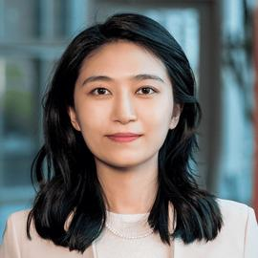
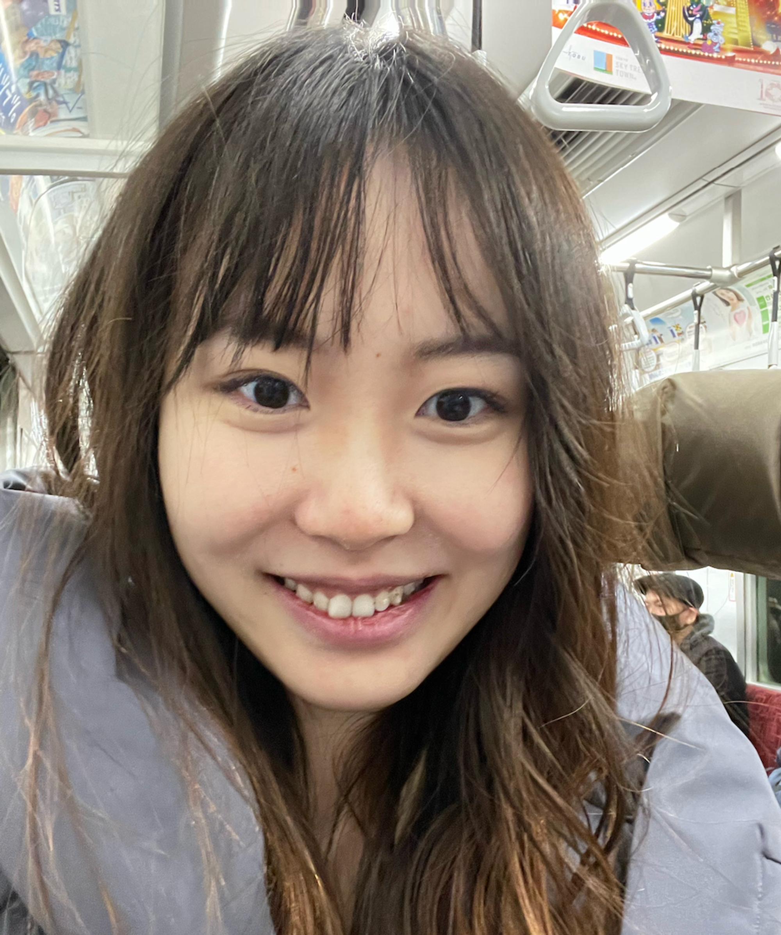
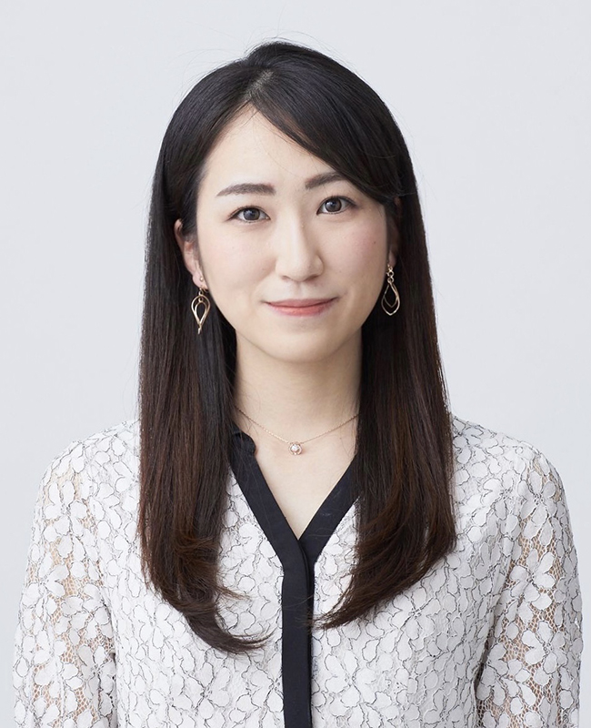
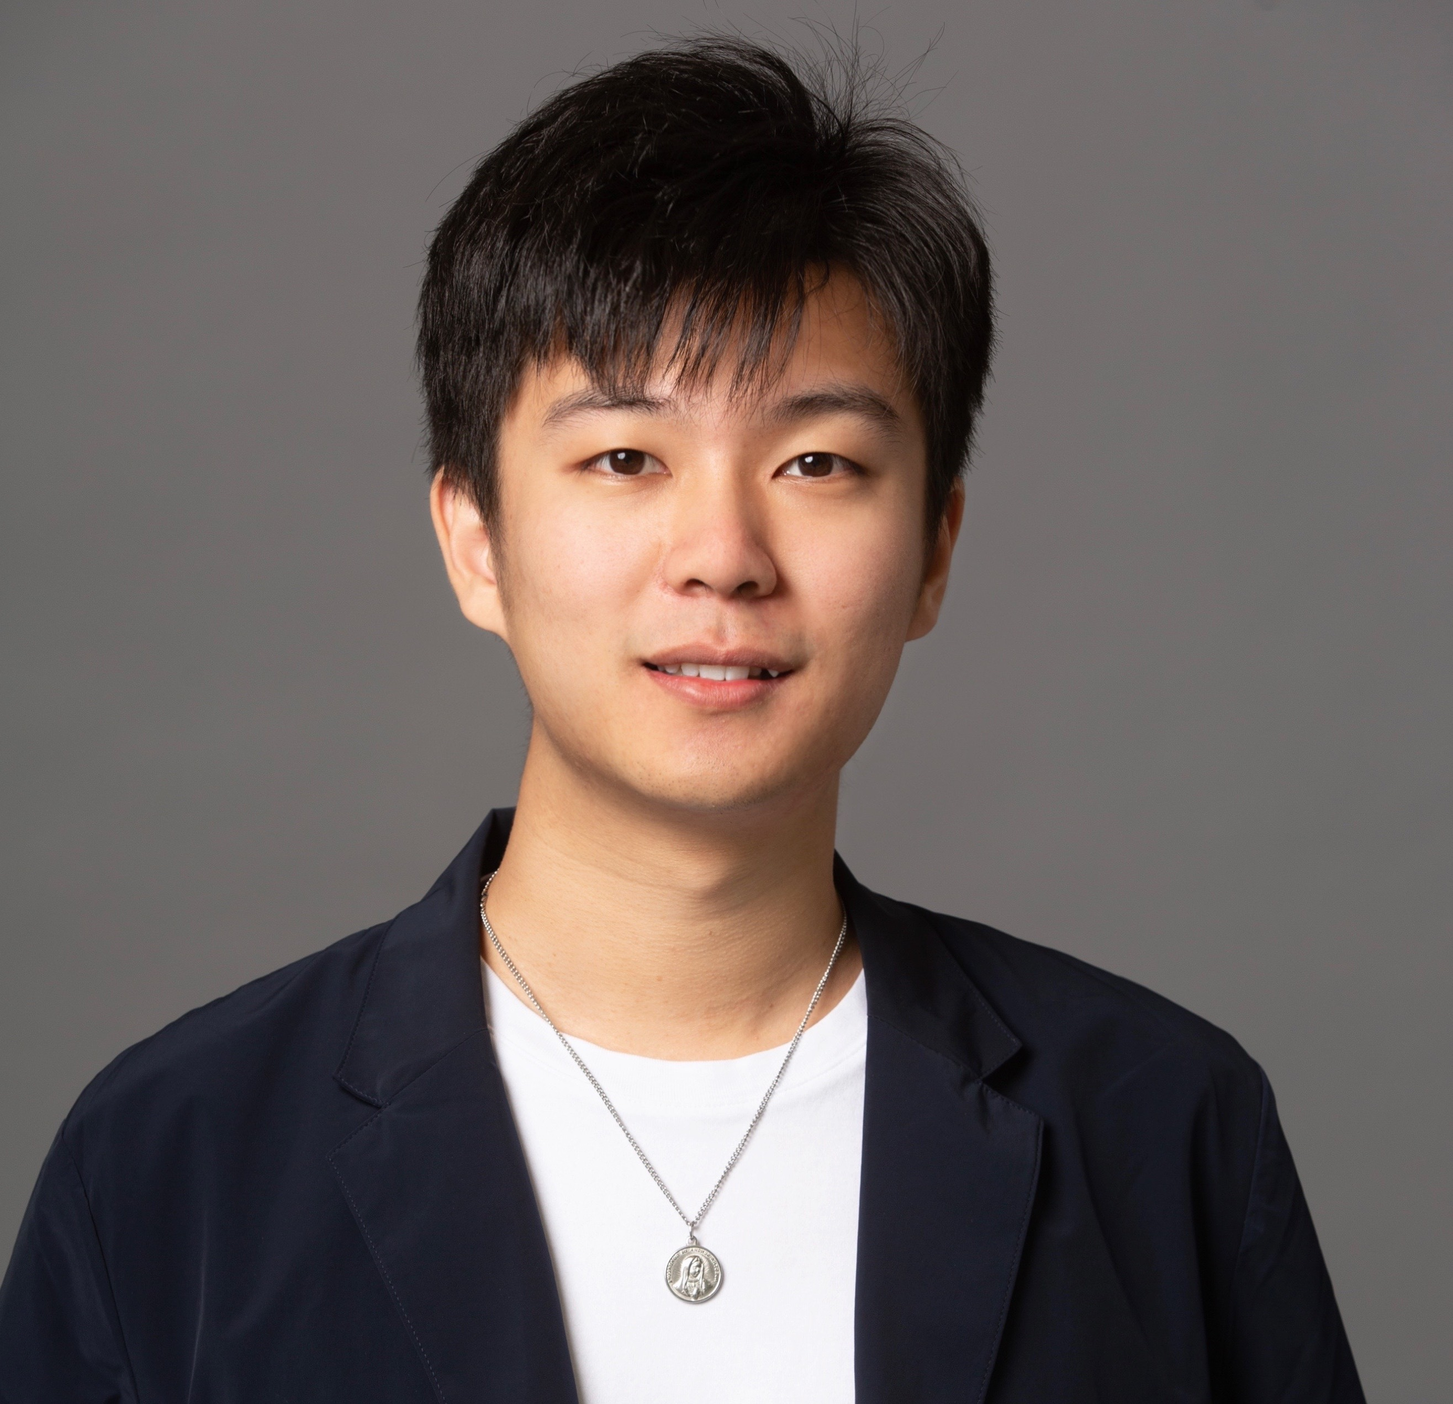
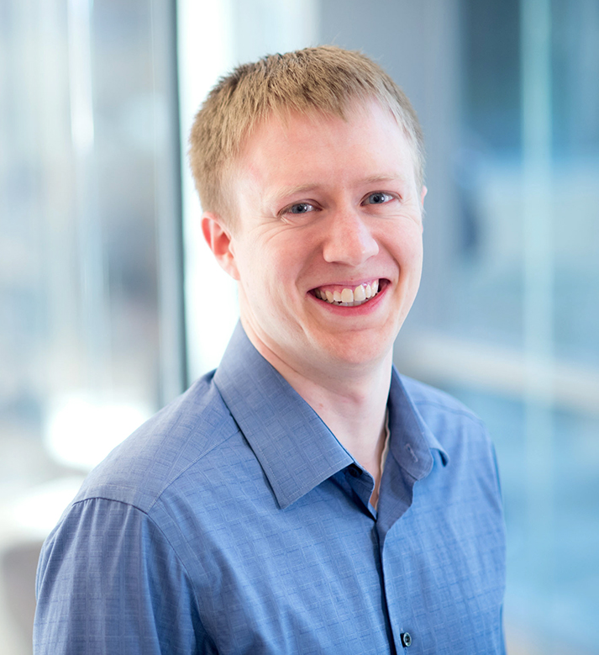
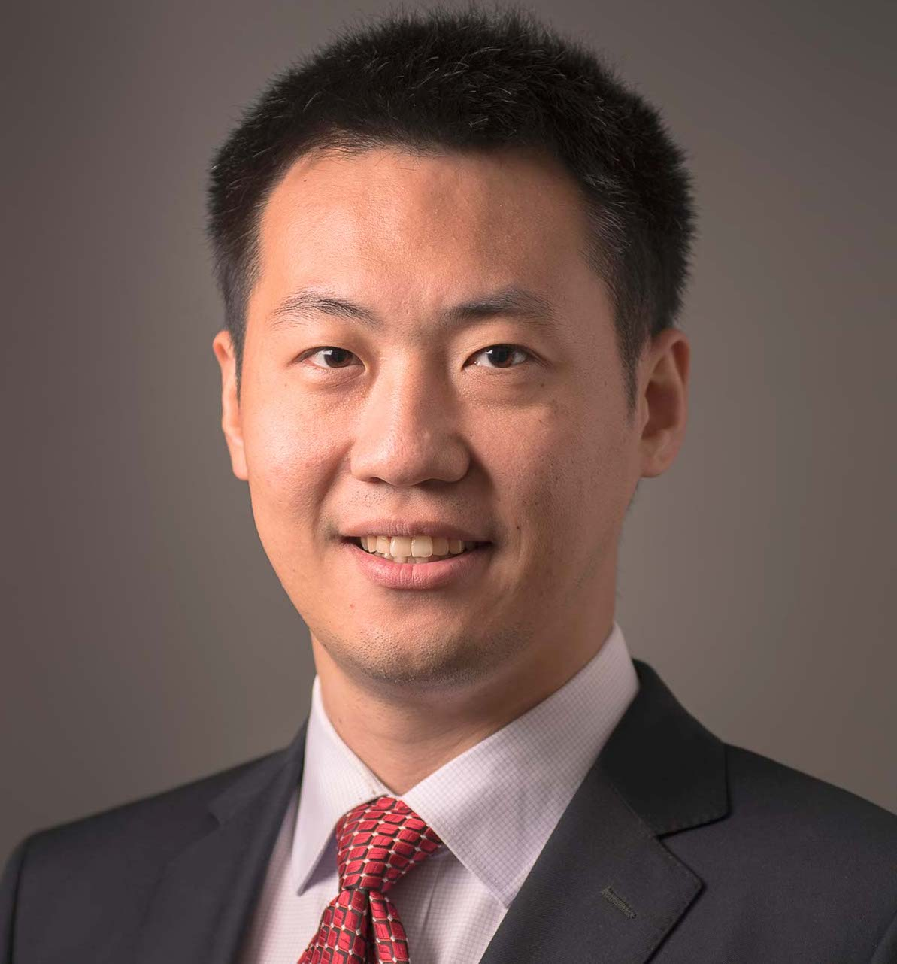
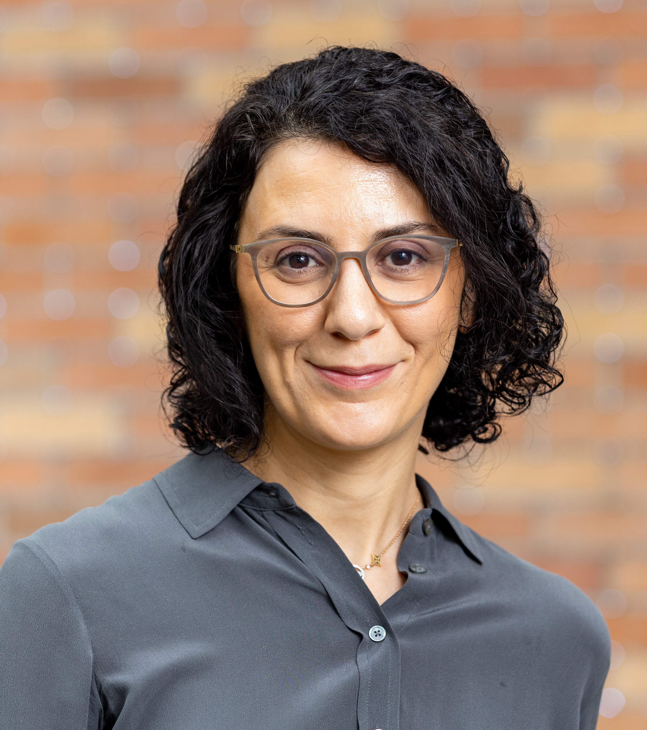
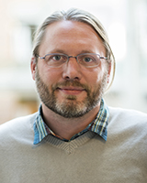
The 4th Workshop on Knowledge-Augmented NLP
Time & Location: Saturday (May 3rd) 9am at La Cienega Room
Speakers
Doug Downey Graham Neubig Yunyao Li Yoav Artzi Hongming Zhang Manling Li
Topcis cover LLM Agents; Scientific Assistant; Knowledge Base; RAG; World Knowledge …
Organizers
Weijia Shi Akari Asai Wenhao Yu Greg Durrett Meng Jiang Hannaneh Luke
Hajishirzi Zettlemoyer

